Slide 1
Actor Recommendation for Casting Directors
(Project Proposal for Building Knowledge Graphs)
Vijayakumar Gedigeri
Yiming Liu
Sep 15th 2017

Slide 2

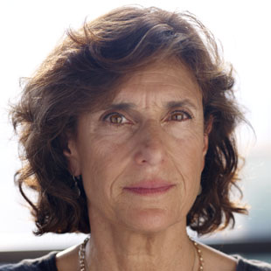
Problem Definition
Avy Kaufman, Casting Director
It took her 3 months to look through thousands of actor profiles, audition videos to find the best match for the lead role

Slide 3

Current Solution
Search for actors with character description
Age, Gender, Height, Physical Characteristics etc.
Returns list of 1000’s of actors
Doesn’t consider actor’s previous works
Lot of work for casting directors to narrow down the list
Not a concrete solution

Slide 4
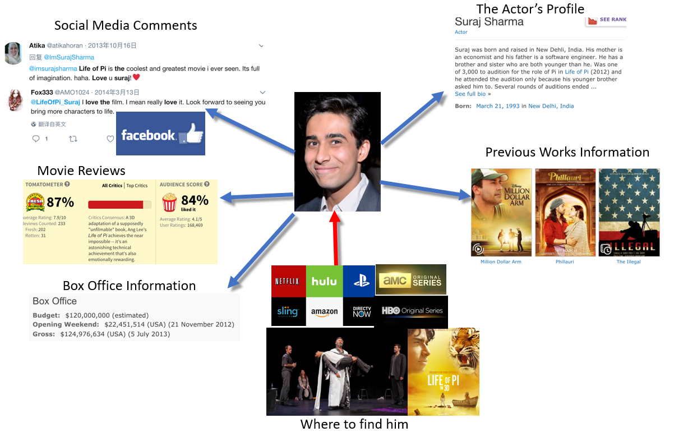
Proposed Solution
Build a knowledge graph of actors for casting directors
Explore the Long Tail to recommend lesser known potential movie stars
Input:
Character Description
Genre of the movie
Output:
List of actors with ranks
Profile Information and Links
Rank by combining their popularity on Social Media
Gross Income, Awards
Netflix Originals, Amazon Movies, HBO Shows
Theatre artists / Stage Actors

Slide 5







Sources

Slide 6
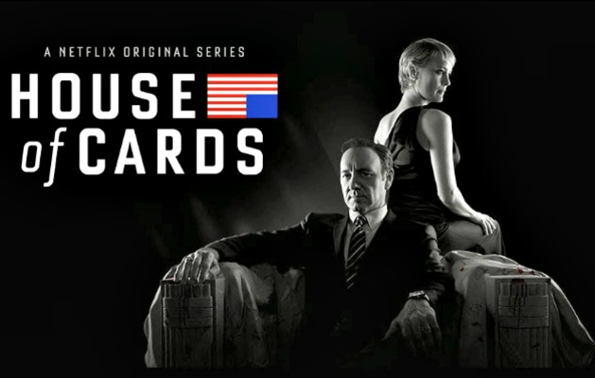
Challenges
Popular actors might undermine less popular, unknown actors
Limited data on stage actors
Mismatch in actor’s names across sites

Slide 7
Thank you

Slide 9

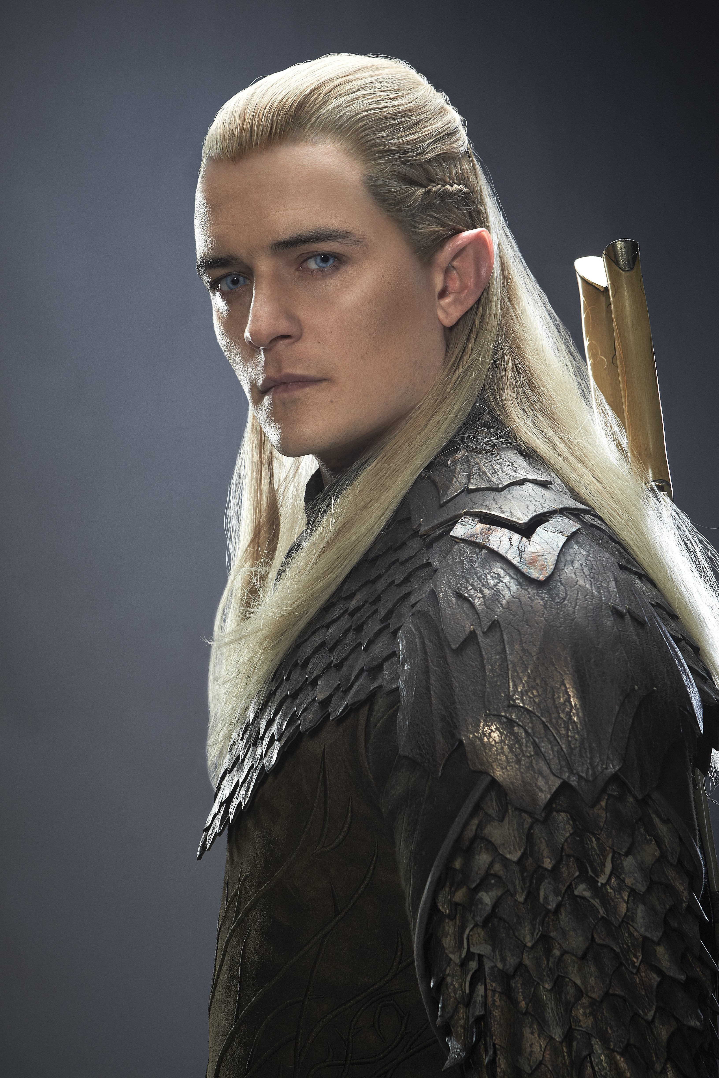
Details
Get actors list from
Netflix Originals, Amazon Movies, HBO Shows
Theatre artists / Stage Actors
Match needs with actor’s previous works
Collect Previous Movie Records – Gross Income, Awards
Rank by combining their popularity on Social Media

